Slide 1



GOOD MORNING EVERYONE

Slide 2
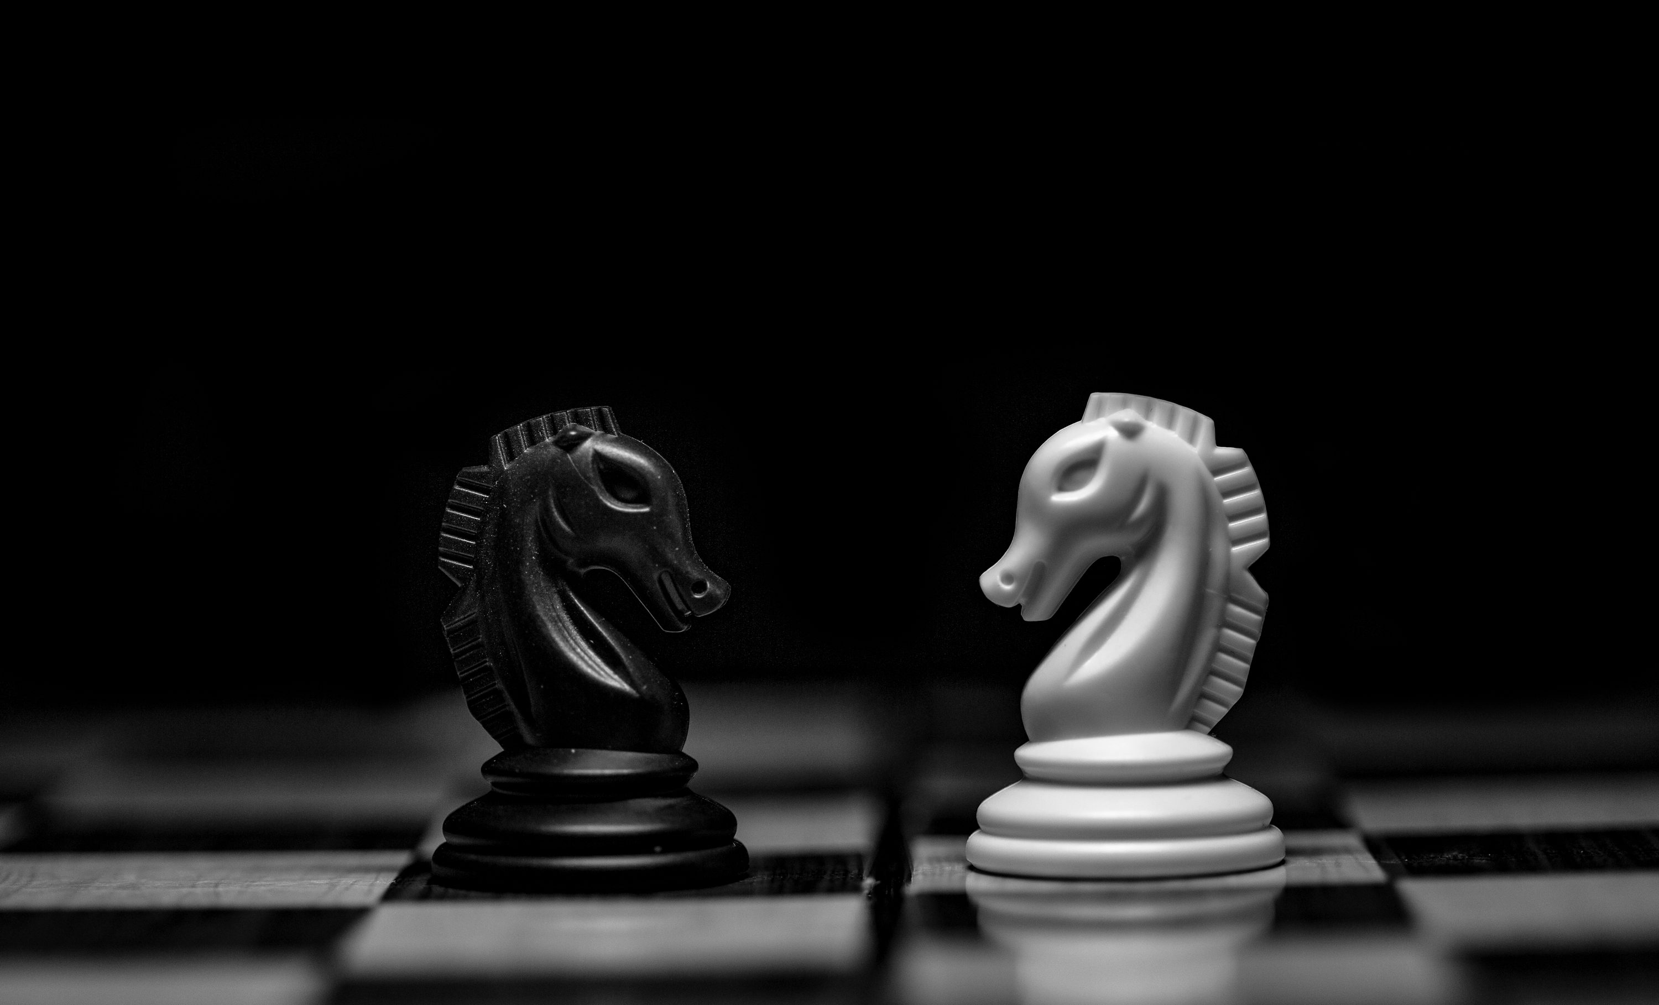

INTRODUCING NEW
PROJECT-
BATTLE OF CHESS
COMPETITION

Slide 3
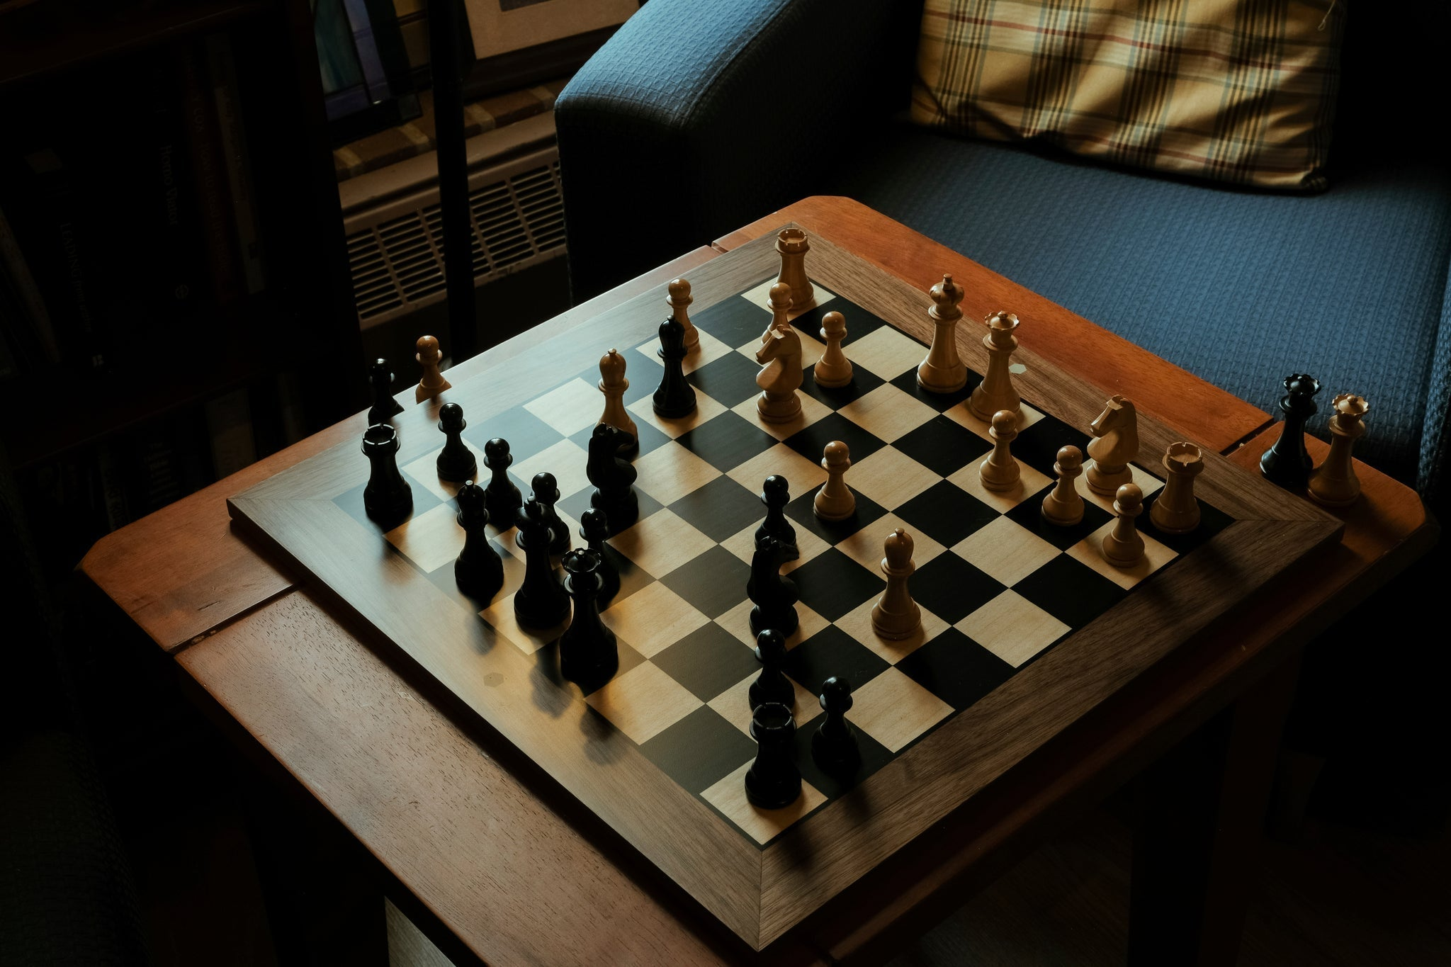
CHESS IS ROUGHLY 1,500 YEARS AGO
CHESS GAME IS THE PROMIENT GAME IN THE WORLD

Slide 4
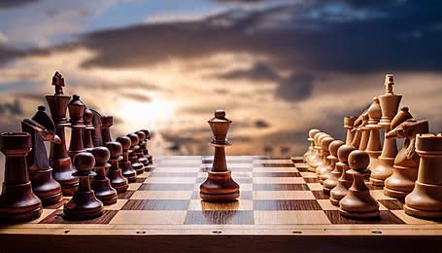
INCREASING PERSONALITY DEVELOPMENT
INCREASING
DECISION TIME
PLANNING
FOSTER
EMOTION
INTELLIGENCE

Slide 5
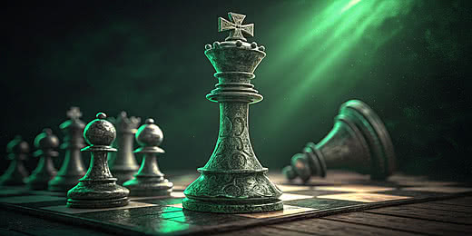
FIRST PRIZE – 21,000$
SECOND PRIZE - 11,000$
THIRD PRIZE- 5,000$
VENUE: M.G ROAD, PUNE
TIME : 10:00AM TO 5:00PM
PHONE.NO: 94738XXXXX
COMEBACK IN BATTLE AND
SHOW YOUR
TALENT
EILIGIBLE: ALL CAN PARTICIPATE

Slide 6

This Photo by Unknown Author is licensed under CC BY-SA

